Slide 1
Healthy Eats Application
Ben Gonzalez, Dan Mendoza, Xavier Byrd
Fall, 2019
Notes:
Ben, Dan, Xavier

Slide 2
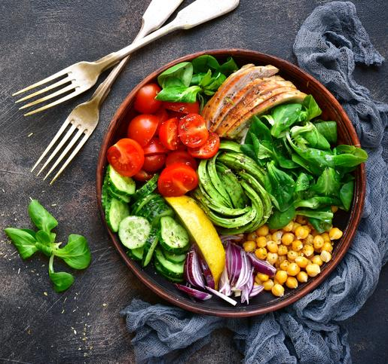
Agenda
Project Background
Architectural Design Overview
Use Case Diagram
Class Diagram
Sequence/Activity Diagram
Project Status
Application Demonstration
Lessons Learned
Notes:
Dan

Slide 3
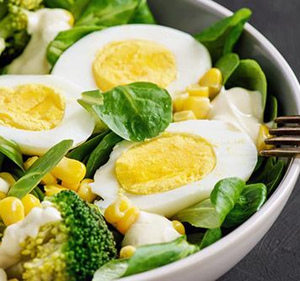
Project Background
What is Healthy Eats?
It is an application that provides list of restaurants that serve healthy meals specific to the user’s health condition and location.
Why Healthy Eats?
This application is design to help user choose healthy meals near the area conveniently.
Notes:
Dan

Slide 4
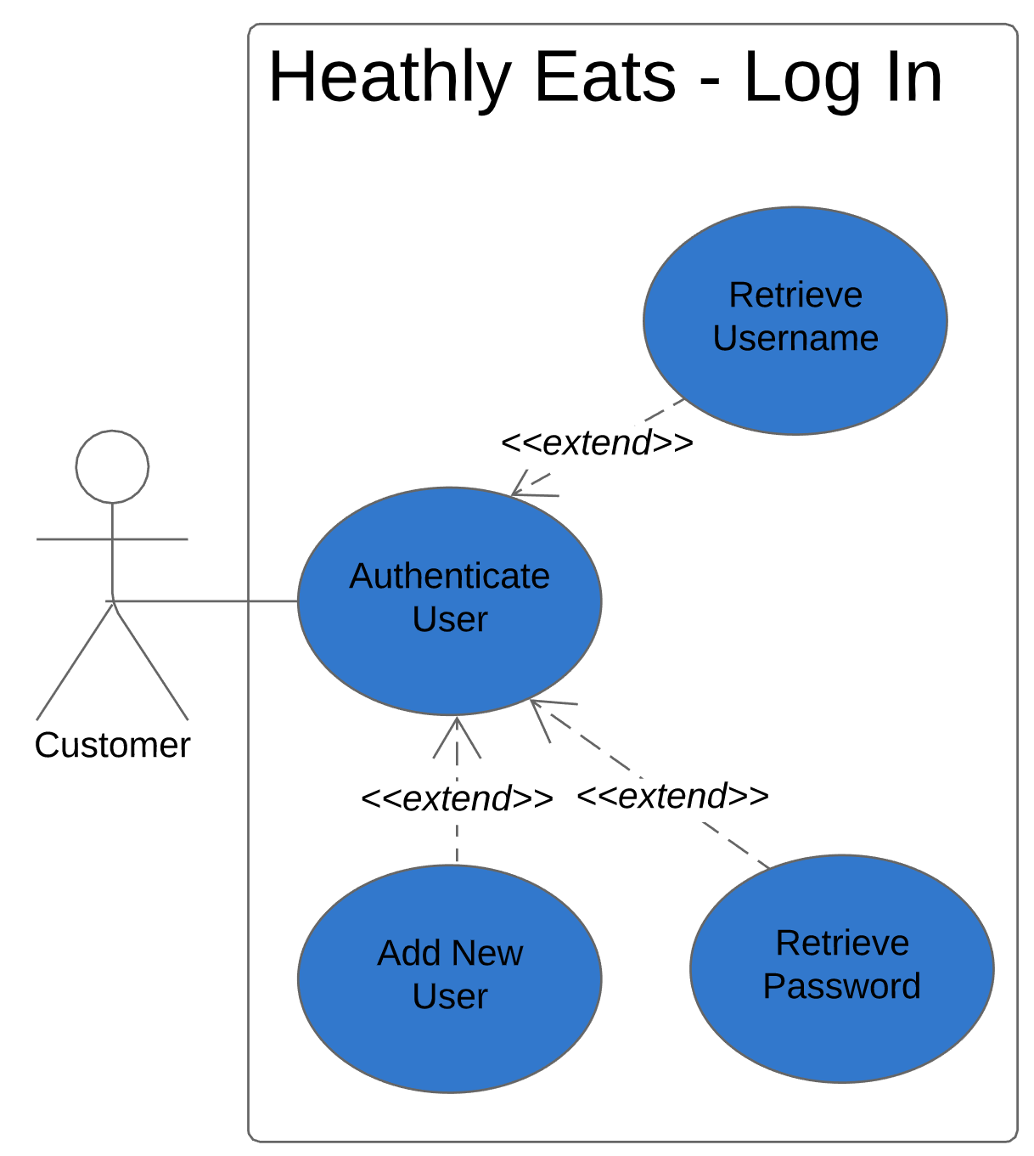
Design: Level 2 UML Use Case Diagram - Log-In
Notes:
Dan

Slide 5
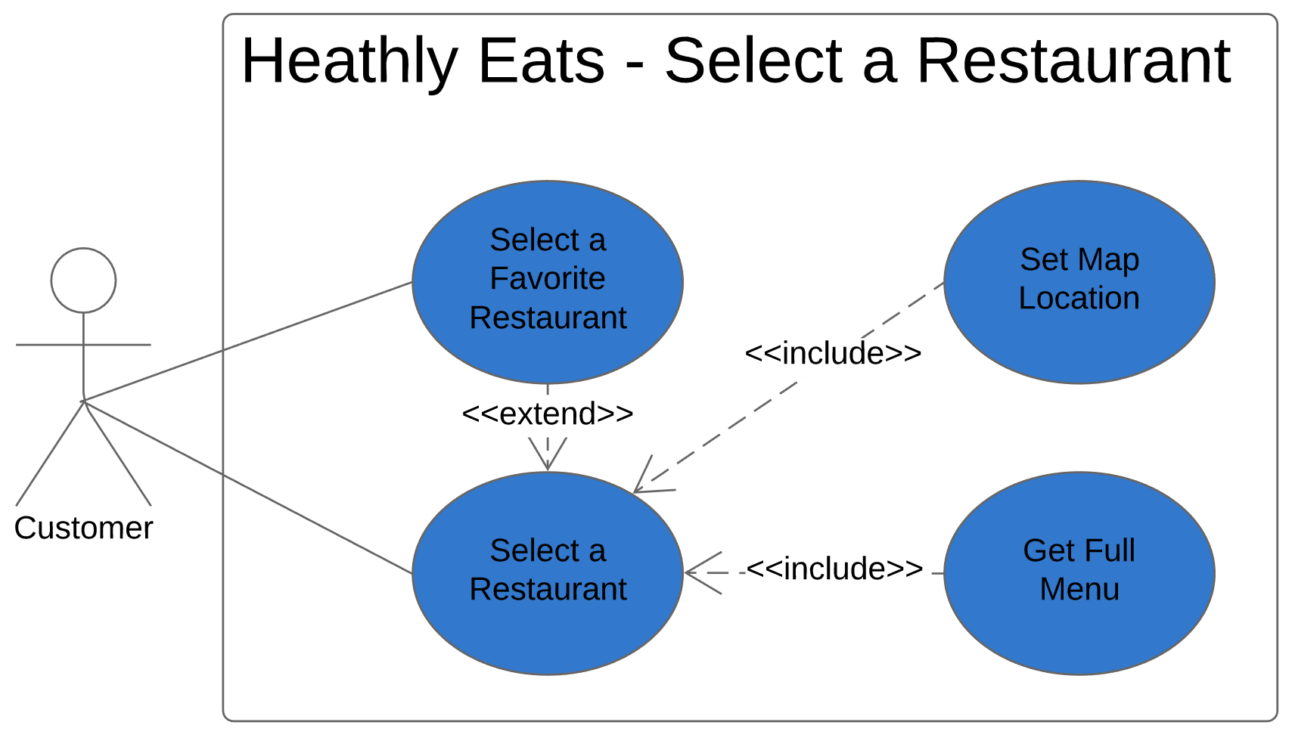
Design: Level 2 UML Use Case Diagram - Select Restaurant
Notes:
Dan

Slide 6
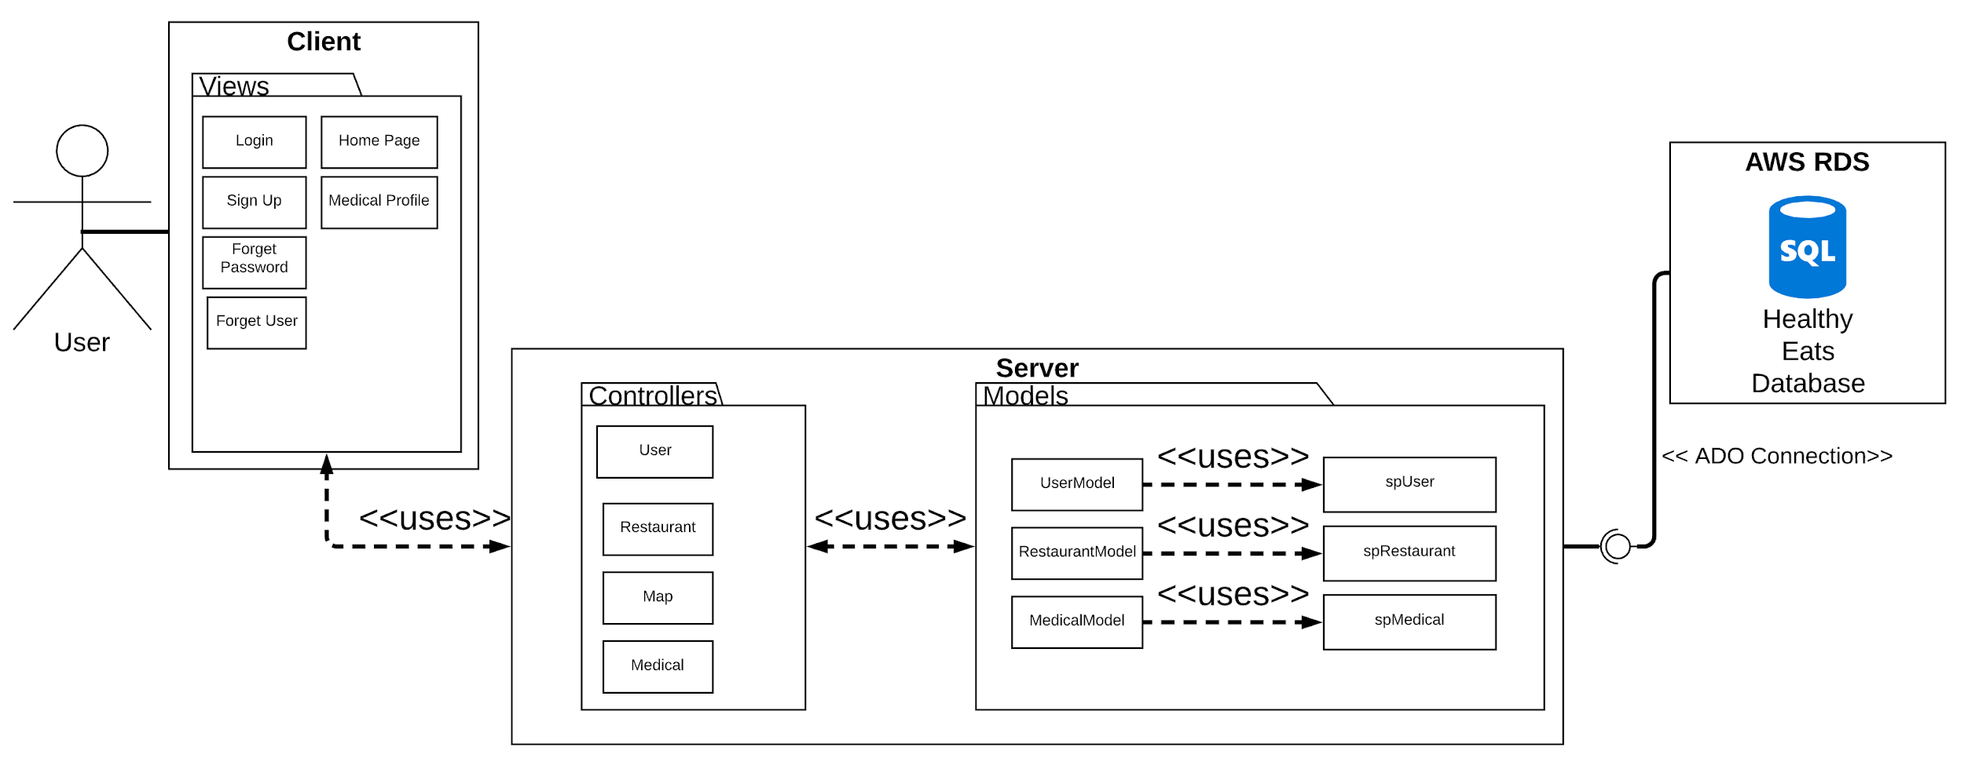
Design: Class Diagram Overview
Notes:
Ben MVC

Slide 7
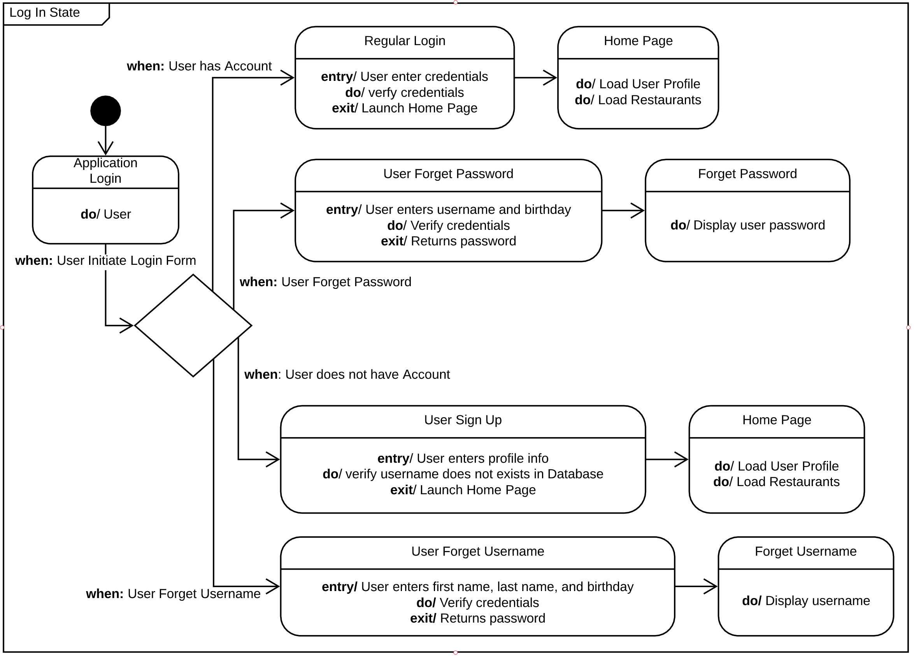
State Diagram: Log-In
Notes:
Ben

Slide 8
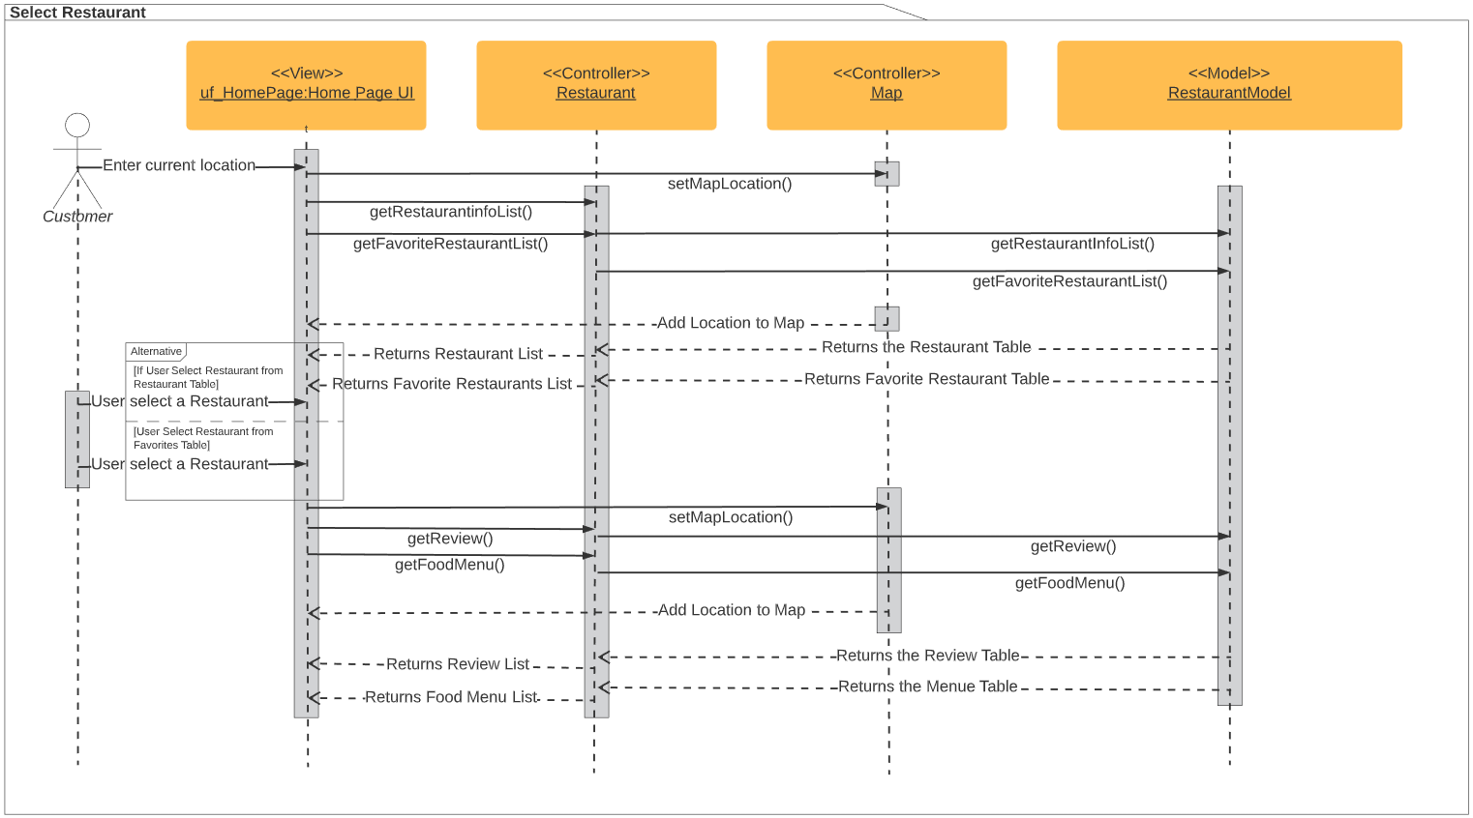
Sequence Diagram: Select Restaurant
Notes:
Xavier

Slide 9
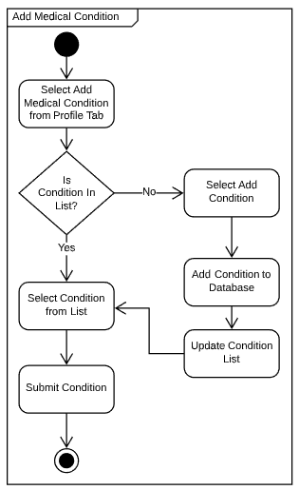
Activity Diagram: Add Medical Condition
Notes:
Xavier

Slide 10

Lessons Learned
Team Collaboration and Synchronization: we learned how to develop an application with multiple developers and established project scope and timeline.
Time Management: we learned how to utilize different ways of communication and resolving conflicts.
Adaptability: we learned how to quickly use new program languages (C# and SQL).
Formal Documentation: we learned how to write formal project documentation and diagrams.
Database Utilization: we learned how to build one from scratch and how to use it.
New Features: we learned how to make a google map.
Notes:
Ben

Slide 11

Project Status
Application Development 100%
Application Testing
100%
Documentation 100%
Presentation 100%
Project Completed
Project Design 100%
Notes:
Xavier - Based on our planned project we have completed our milestones that were in our time constraint.

Slide 12

Questions?

